Slide 1


SQL Like Languages in Azure IoT
Rastko Djordjevic
Catalin Gheorghiu I Computer Solutions

Slide 2
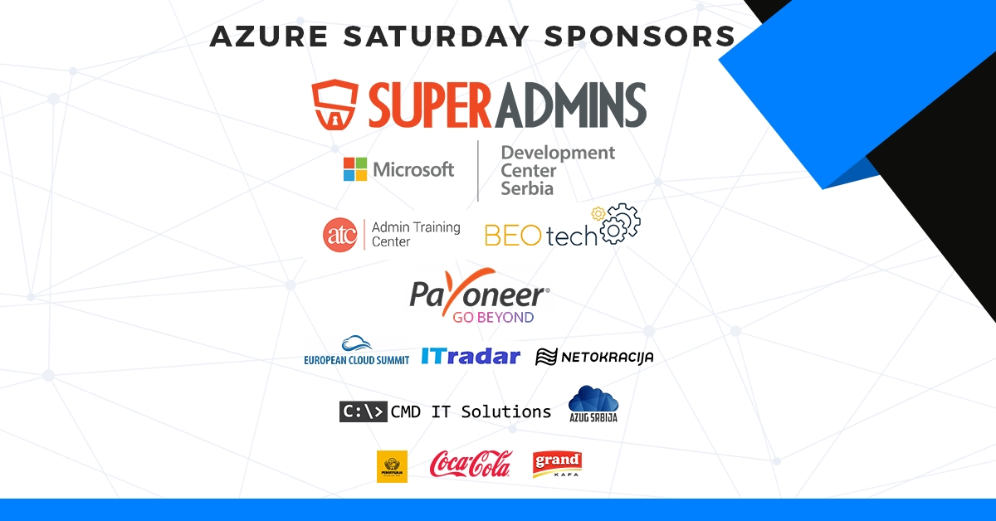

Slide 3
SQL WHERE
IoT Hub
Stream Analytics
Time Series Insights

Slide 4
Thank you! Hvala! Q&A and contact info
Blog TDB ☺
My Email catalin.gheorghiu@ronua.ro

Slide 5
SQL Like Languages in Azure IoT
Rastko Djordjevic
Catalin Gheorghiu

Slide 6
Links
200 USD Azure https://azure.microsoft.com/en-us/free/
Pi Simulator https://azure-samples.github.io/raspberry-pi-web-simulator/
IoT Hub query language for device and module twins, jobs, and message routing https://docs.microsoft.com/en-us/azure/iot-hub/iot-hub-devguide-query-language
Routing messages with IoT Hub (.NET) https://docs.microsoft.com/en-us/azure/iot-hub/iot-hub-csharp-csharp-process-d2c#route-messages-to-a-queue-in-your-iot-hub
Query examples for common Stream Analytics usage patterns https://docs.microsoft.com/en-us/azure/stream-analytics/stream-analytics-stream-analytics-query-patterns
Query Language Elements (Azure Stream Analytics) https://msdn.microsoft.com/en-us/azure/stream-analytics/reference/query-language-elements-azure-stream-analytics
Query Language Elements (Azure Stream Analytics) – Windowing https://msdn.microsoft.com/en-us/azure/stream-analytics/reference/windowing-azure-stream-analytics
Create a new Time Series Insights https://docs.microsoft.com/en-us/azure/time-series-insights/time-series-insights-get-started

